Slide 1
UNIT II Data Modeling using Entity-Relation Model

Slide 2
Database Design Process
DBMS is designed to manage large volume of information.
Database design is a collection of processes that facilitate the designing, development, implementation and maintenance of database systems.
DBMS is designed to meet the requirements of the users.
It has high performance.
Following processes are needed for database design:
Requirement Collection and Analysis
Conceptual database design
Selection of a DBMS
Implementation
Physical database design
Logical database design

Slide 3
Database Design Process
Requirements collection
Database designers interviews to database users for their requirements.
It also can be divided into two parts:
Planning: it mainly concern with planning of entire database development life cycle.
System definition: it defines the scope and boundaries of proposed database system.
Functional requirements:
It consists of user defined operations.
Data requirements: different types of data that are required to model database.
2. Conceptual design:
it concisely or briefly describe the data requirements and their types, relationship and constraints.
It does not describe the implementation detail and non technical person can also understand and no redundant data.
ER diagram is used.

Slide 4
Database design process
Logical database design
It creates well structured tables, describes attributes ,their types and relationship among tables.
Actual implementation of the database is done in logical database design.
Implementation details are used.
Physical database design
Main purpose of this design is to optimize performance, to ensure data integrity by avoiding redundant data.
Describes the detail of how data are stored, defines tables and relationship among tables.

Slide 5
Entity Types and Entity sets
Entity: It is something which has real existence. For example: Tuple 1 contains information about Aarav(Id, Name, and Age) which has existence in real world, so tuple 1 is an entity.
ENTITY
Entity Type: It is a collection of entities having common common attributes. For example: Student
Entity Type
Sita
Student

Slide 6
Entity Set
It is same as an entity type, but defined at a particular point in time. For example student enrolled in a class on the first day.
Entity set
E1
E2
E3
E4
E5
E6

Slide 7
Attribute
Attributes: descriptive properties possessed by an entity set. E.g. student has name, age, address
Types:
Simple attribute − Simple attributes take atomic values. E.g. student's roll no.
Composite attribute − Composite attributes are made of more than one simple attribute. E.g. student's complete name may have first_name and last_name.
Single-value attribute − Single-value attributes contain single value. For example − Social_Security_Number
Multi-value attribute − Multi-value attributes may contain more than one values. For example, a person can have more than one phone number, email_address
Derived attribute: whose values are derived from other attribute present in the database, e.g.. Avg(salary)

Slide 8
Attribute
Stored attribute: it is such type of attributes which is stored physically in the database. For example: Name, address, roll no attributes can not be derived from any other attributes.

Slide 9
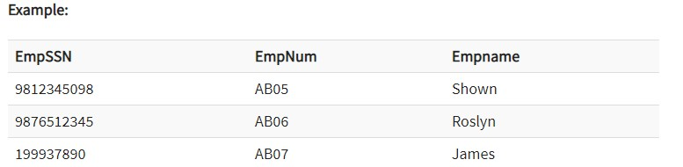
Keys
A DBMS key is an attribute or set of an attribute which helps you to identify a row(tuple) in a relation(table).
They allow you to find the relation between two tables. Keys help you uniquely identify a row in a table by a combination of one or more columns in that table.
Super key:
A superkey is a group of single or multiple keys which identifies rows in a table. A Super key may have additional attributes that are not needed for unique identification.

Slide 10
Keys
It is superset and uniquely identify tuples.
In the above-given example, {EmpSSN} and {EmpNum},{ EmpNum, EmpName}, { EmpSSN, EmpName} etc are superkeys.
2. Candidate key: Minimal subset of super key. It can not be null and can be more than one candidate key.
For example: EmpNum, EmpSSN.

Slide 11
Key
3. Primary Key: it is also candidate key which is most appropriate to become the main key. Can not be null and duplicate value.l
For example: {EmpNum}
4. Composite key: It consists of two or more attributes that uniquely identify any record in a table is composite key. For example: {EmpNum} is primary key and { EmpNum, EmpName} is composite key.

Slide 12
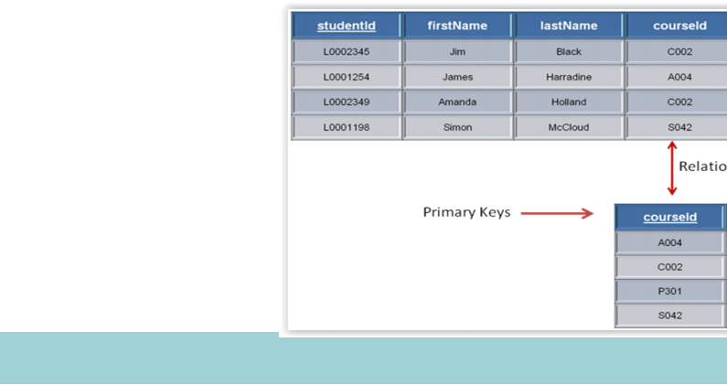
Key
5. Foreign key: Foreign keys are the columns of a table that points to the primary key of another table.

Slide 13
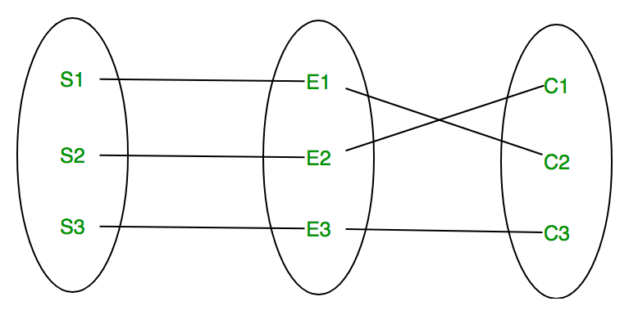
Relationship Type
Relationship type: It represents the association between entity type. For example, ‘teaches’ represents relationship type. In ER diagram, relationship type is represented by diamond shape and connecting the entities with lines.
Relationship set: It is the association between two entities sets is called relationship type.
teaches
Teacher
students

Slide 14
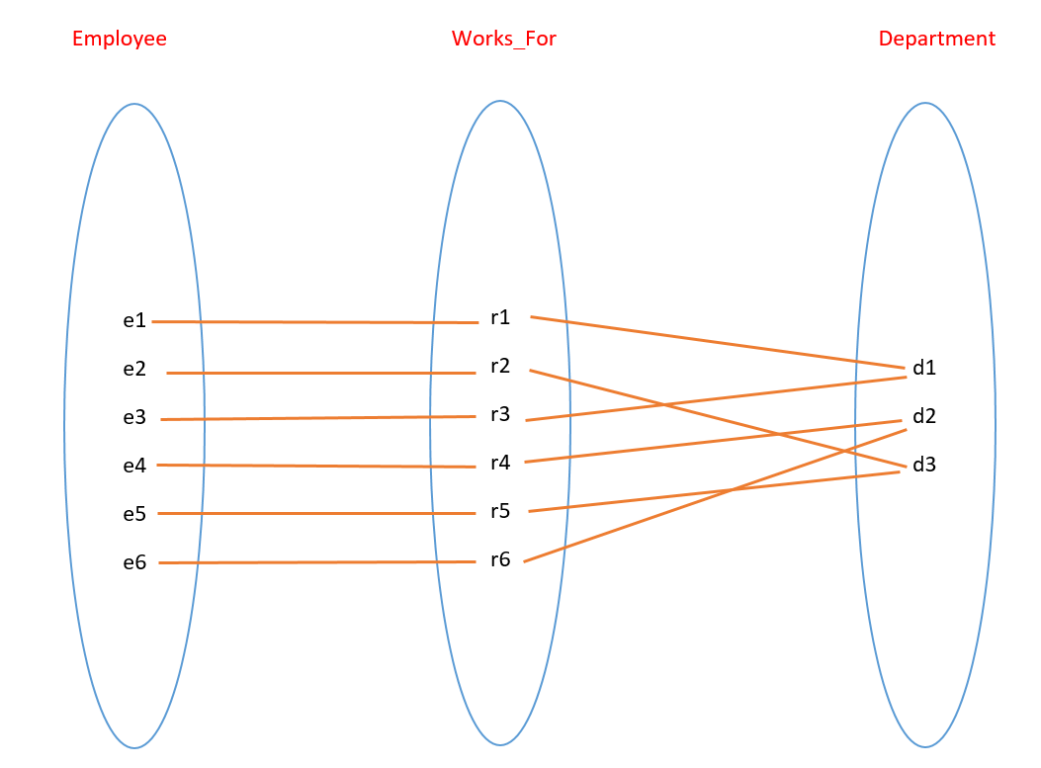
Relationship instance
A relationship instance in R is an association of entities, where the association includes exactly one entity from each participating entity type.
Relationship instance and degree of a relationship type

Slide 15
Degree Of a relationship
Number of entities-sets that participate in a relationship set is called degree of the relationship set. On the basis of degree, relationships can be divided as below:
Unary relationship
Binary relationship
N-ary relationship

Slide 16
Unary relationship
If only one entity set participates in a relation, the relationship is called as a unary relationship. There are three types of unary relationship:
1:1 unary relationship (one person married to another person)
1:M unary relationship(one employee manages to many students)
M:N unary relationship: A subject may have many others subjects as prerequisites and each subject may be a prerequisite to many other subjects.

Slide 17
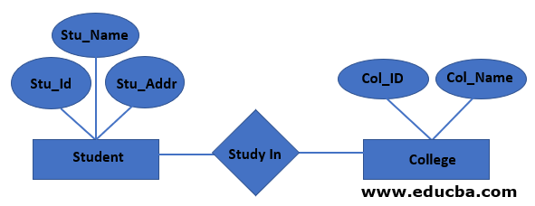
Binary Relationship
When there are two entities set participating in a relationship, the relationship is called as binary relationship.

Slide 18
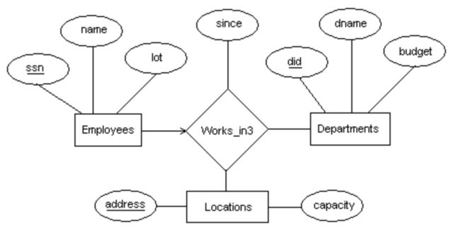
N-ary Relationship
When there are n entities set participating in a relationship, the relationship is called as n-ary relationship.

Slide 19
Structural Constraints
relationship set in ER model usually have certain constraints that limit the possible combinations of entities that may involve in the corresponding relationship set. The main two structural constraints in ER are listed below:
Mapping cardinality.
Participation constraints.
Mapping cardinality constraints: the number of times an entity of an entity set participates in a relationship set is known as cardinality. Cardinality can be of different types:

Slide 20
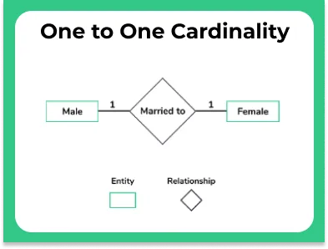
Mapping cardinality
One to one mapping
One to many mapping
Many to one mapping
Many to many mapping
One to one: In one to one mapping, an entity in E1 is associated with at most one entity E2 and vice versa.

Slide 21
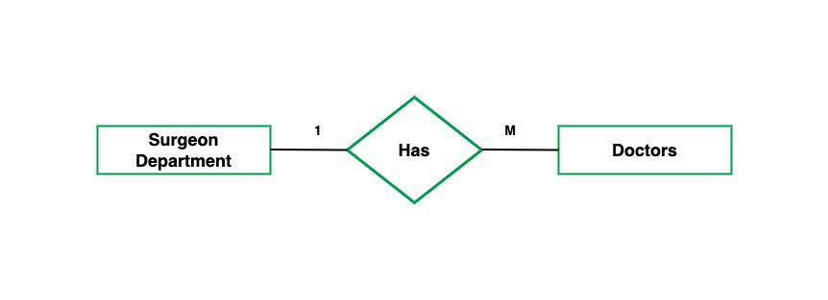
One to many or many to one: An entity in E1 is associated with any number of entities in E2, and an entity in E2 is associated with at most one entity in E1 and vice versa.

Slide 22
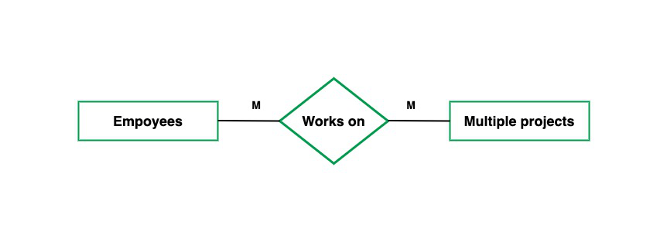
Many to many: In many to many mapping, an entity in E1 is associated with any number of entities in E2 and vice versa.

Slide 23
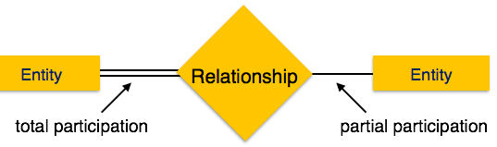
Participation constraints
Participation constraint is applied on the entity participating in the relationship. There are two types of participation constraints:
Total participation constraints
Partial participation constraint
Total participation: all the entities in the entity set are involved in relationship. Represented by double lines.
Partial participation: Not all entities are involved in the relationship. Partial participation is represented by single lines

Slide 24
Strong Entity Set Vs Weak Entity Set
The basic difference between strong entity and a weak entity is that the strong entity has a primary key whereas, An entity set that does not have sufficient attributes to form a primary key is termed a weak entity set.
A weak entity always depends on the strong entity for its existence whereas, a strong entity is independent of any other entity’s existence.
A strong entity is denoted with a single rectangle and a weak entity is denoted with a double rectangle.
The relationship between two strong entities is denoted with single diamond whereas, a relationship between a weak and a strong entity is denoted with double diamond called Identifying Relationship.

Slide 25
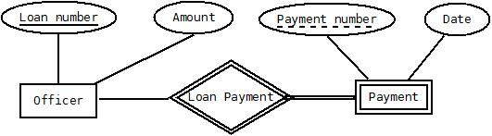
Partial Key
Primary key uniquely identifies the record in the entity and used in strong entity type. In weak entity there their is partial key.

Slide 26
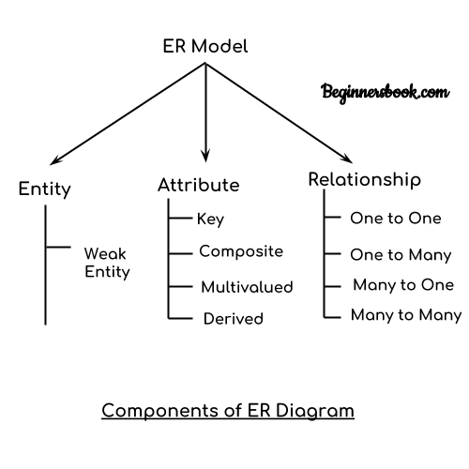
Notation of E-R diagram

Slide 27
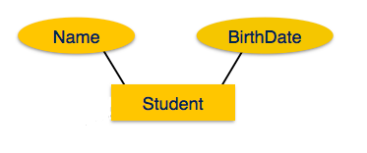
ER Diagram
ER diagram are used to represent ER models
An entity type is represented with a labelled rectangle
An attribute is represented with a labelled oval or ellipse, connected to an entity type with a line.

Slide 28
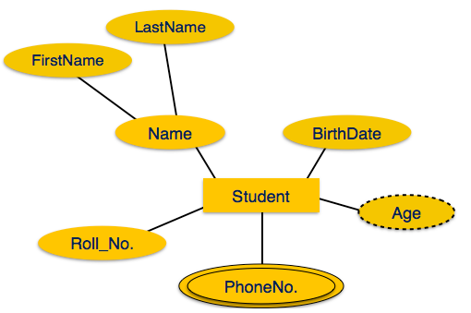
ER Diagram
If the attributes are composite, they are further divided in a tree like structure
Multivalued attributes are depicted by double ellipse
Derived attributes are depicted by dashed ellipse

Slide 29
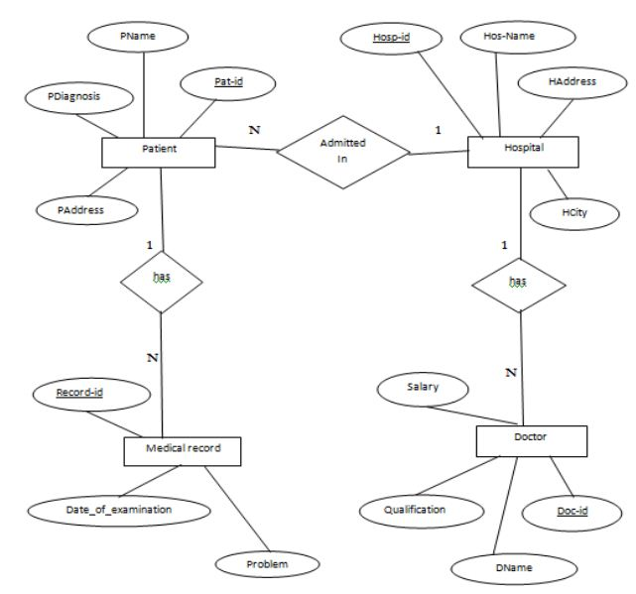
Hospital management System

Slide 30
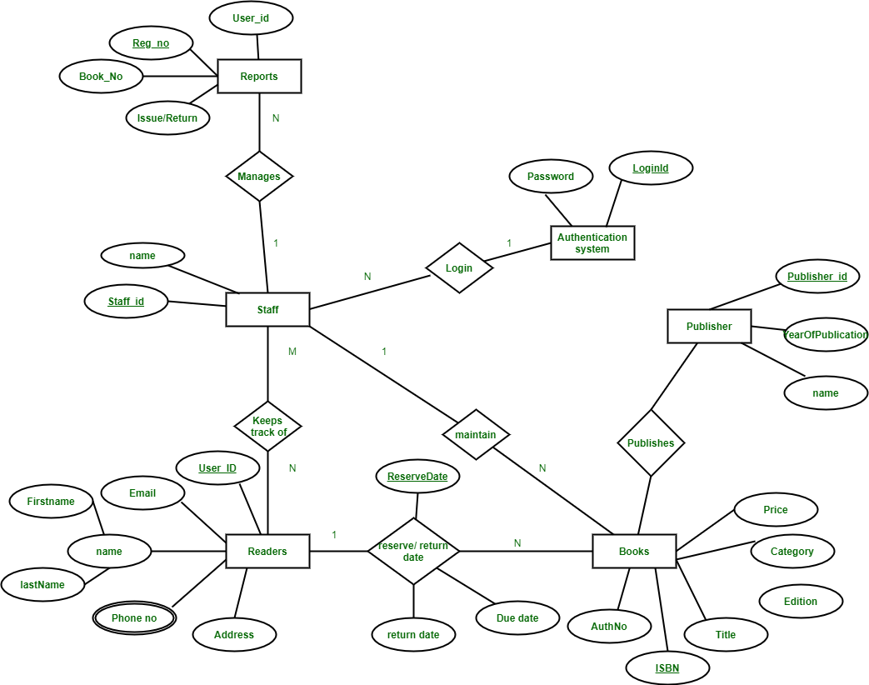
Library management System

Slide 31
Design issues
Designing an entity-relationship diagram involves identifying entities, their attributes, and the relationship between them. Common design issues in ER diagrams include:
Entity identification: It includes failing to identify all relevant entities in the system or combining multiple entities into one, leading to loss of information.
Redundant attribute
Redundant attribute
Missing attribute
Relationships:
Incorrect cardinality
Missing relationships
Failure to normalize.
Improper and missing keys.
Overuse and underuse of hierarchy.

Slide 32
Types of degree higher than two
(Please go to our previous slide of N-ary relationship)
Extended E-R diagram: To describe any system more briefly some special features should be added in existing E-R diagra some of them are as follow:
Subclasses and super classes.
Specialization and specialization.
Aggregation
Union.

Slide 33
Super class: super class is an entity type that has a relationship with one or more subtypes. Inheritance is the process of deriving properties from super classes.
Super class
Sub classes
Shape
d
Square
Triangle
Circle

Slide 34
Extended ER features
Specialization: It is a top-down approach in which one higher level entity can be broken down into two lower level entity
In other words, creating new sub classes from an existing class
Additional attributes are assigned
Such relationship are called ISA or superclass-subclass relationship
It is depicted by triangle component labeled ISA.

Slide 35
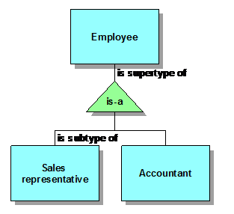
Extended ER features
Generalization: It is a bottom-up approach in which two lower level entities combine to form a higher level entity
two or more classes are combined into a generalized superclass based on common features
It is simple inversion of specialization process.
Generalization: It is a bottom-up approach.

Slide 36
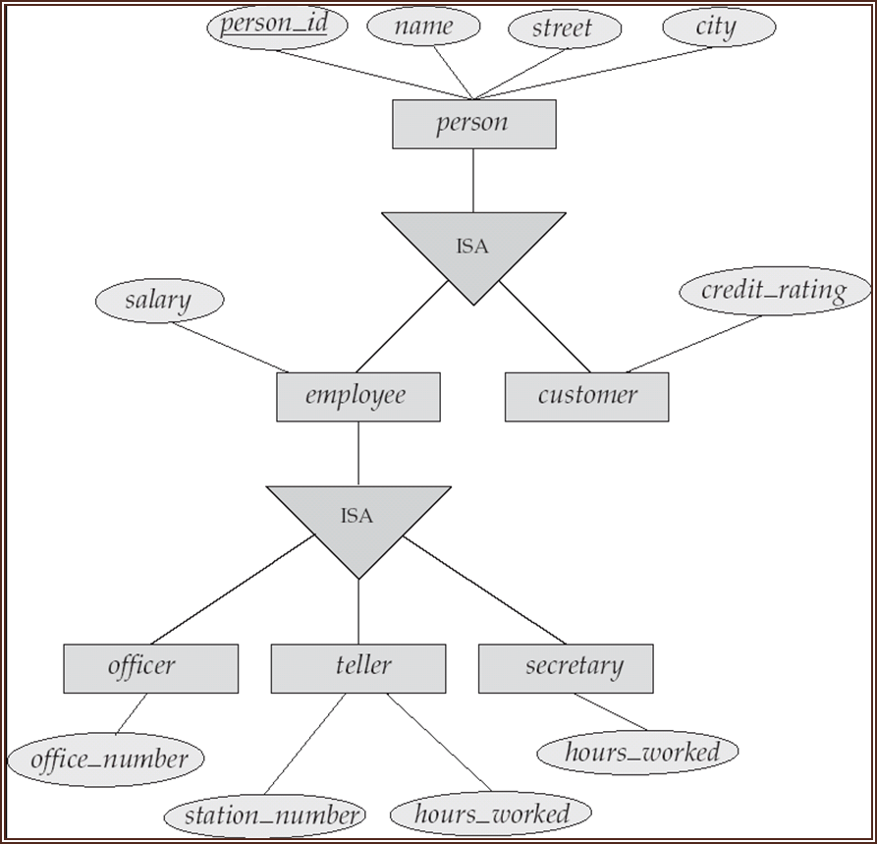
Example

Slide 37
Characteristics of specialization and generalization
Enhanced query performance.
Attribute specialization.
Completeness.
Inheritance
Hierarchical structure.
Integration with normalization.

Slide 38
Converting ER-Diagram to Table
Entity type becomes a table.
All single-valued attribute becomes a column for the table.
A key attribute of the entity type represented by the primary key
The multivalued attribute is represented by a separate table.
Composite attribute represented by components.
Derived attributes are not considered in the table.

Slide 39
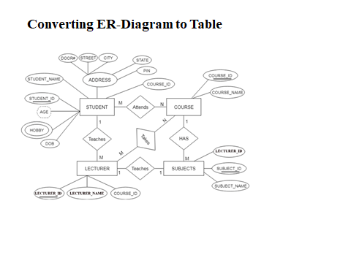

Slide 40
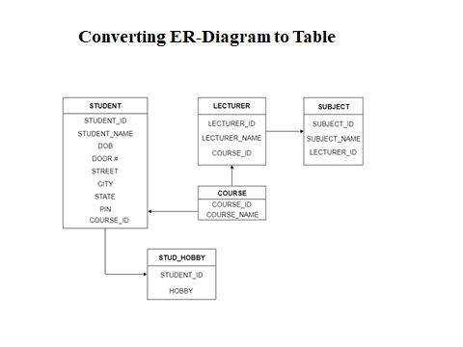

Slide 41
Overlapping and disjoint constraints
Overlapping constraint: overlapping constraints allow an entity to belong to more than one subtype simultaneously. For example: overlapping constraint would allow a specific vehicle to be both a car and a motorcycle simultaneously.
Disjoint constraints: Disjoint constraints require an entity to belong to only one subtype. For example: An entity can be either a car or a motorcycle or both.

